Slide 1
Simon Says
LAMP

Slide 2
Simon says…
Find “I like”

Slide 3
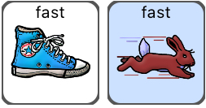
Simon says…
Find “run fast”

Slide 4
Simon says…
Find “silly dog”

Slide 5
Find “cozy home”

Slide 6
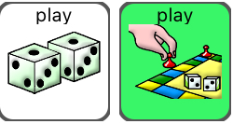
Simon says…
Find “play more”

Slide 7
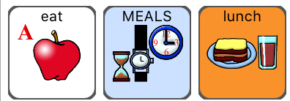
Simon says…
Find “eat lunch”

Slide 8
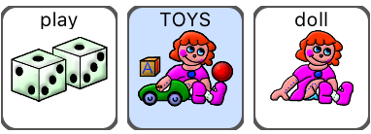
Simon says…
Find “doll”

Slide 9
Find ”go up”

Slide 10
Simon says…
Find “feel crazy”

Slide 11
Simon says…
Find “want help”

